Slide 1
Relational Database Design
Date of Presentation: 6/13/2023

Slide 2
Lesson 4: Functional Dependency (FD)
Gerald Balekaki

Slide 3
Outline
Functional Dependency Theory
Formal definitions
Full Functional Dependency
Partial Dependency
Transitive Dependency
Example: Find FDs in a relation.

Slide 4
Functional Dependency (FD) theory
FD is a fundamental concept in relational database design.
to find keys for relations
to check if relation schema is “good”
It ensures data integrity through constraints
to eliminates data anomalies/inconsistencies (insertion, deletion and update).
FD provides a set of rules for representing relationships between attributes
Definition:
For a given relation R, the values of one set of attributes (dependent) are uniquely determined by the values of another set of attributes (determinant).

Slide 5
Determinant
The determinant is the set of attributes on the left side of the functional dependency arrow (->).
It is the determining factor that uniquely determines the values of the dependent.
Example:
LHS (determinant) -> RHS (dependent)
A -> B (A functionally determines B)
LHS = A (determinant can be more than one attribute)

Slide 6
Dependent
Are set of attributes on the right side of the functional dependency arrow.
Dependents are determined by the values of the determinants.
Example:
LHS (determinant) -> RHS (dependent)
A -> B (B is functionally dependent on A)
RHS = B (dependent can be more than one attribute)
Note:
the relationship from the determinant to the dependent must be “to-one” mapping

Slide 7
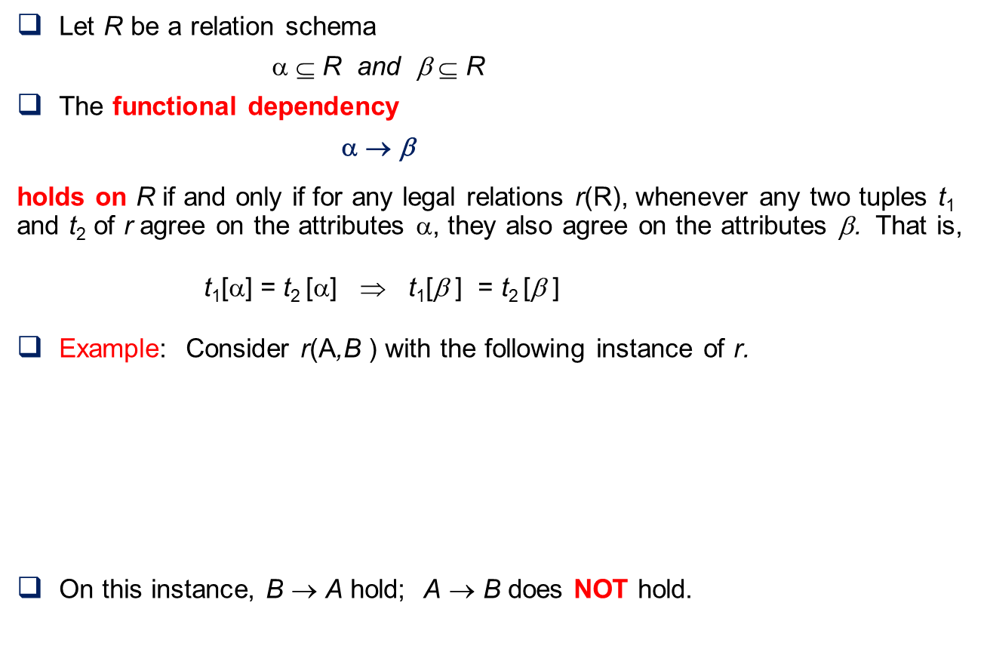
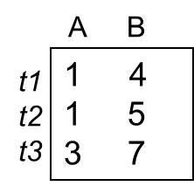
Formal definition of FD
A FD assumes:
to-one mapping

Slide 8
Keys
If attribute(s) X are a unique identifier for the tuples of relation R, and no subset of X are a unique identifier of R, then X is a candidate key
If X -> R,
and no Y ⊂ X such that Y -> R,
then X is candidate key for R.
Any attribute that is part of a candidate key is called a prime key of R.
One of candidate key is chosen as a primary key of a relation R
(also acts as a foreign key reference in other relations)

Slide 9
Full Functional Dependency
A FD is considered full if removing any attribute from the determinant would break the dependency.
all attributes in the determinant are necessary to determine the values of the dependent.
Example:
LHS (determinant) -> RHS (dependent)
AB -> C
LHS = both A and B are needed (C is fully dependent on AB OR AB fully determines C)

Slide 10
Partial Functional Dependency
A FD is partial if it is possible to remove some attributes from the determinant while still maintaining the dependency.
Not all attributes in the determinant are necessary to determine the values of the dependent.
Example:
LHS (determinant) -> RHS (dependent)
AB -> C (either A or B can be removed from LHS )
B -> C (A removed)
(C is partially dependent on determinant - AB)
C is dependent on part of the key/determinant.

Slide 11
Transitive Dependency
Transitive dependency occurs when there is a FD between attributes indirectly through other attributes.
Example:
If A -> B (A is prime key, and B is non-prime key)
and B -> C
then A -> C (transitive dependency)
Note:
an existence of a FD via a non-prime attribute –
is a sign of transitive dependency.

Slide 12
Example: Find FDs in a relation
Consider the relation schema r(A,B,C,D,E) with data values given in each tuple, t1,...,t4.
A B C D E
t1 1 4 5 1 0
t2 1 4 3 2 2
t3 3 4 5 3 0
t4 3 4 3 4 3
Which of the following functional dependencies will NOT hold in the above relation?
a) C -> E
b) E -> C
c) A -> B
d) D -> ABCE
e) DA -> BC
f) B -> C

Slide 13
Example: Find FDs in a relation
Consider the relation schema r(A,B,C,D,E) with data values given in each tuple, t1,...,t4.
A B C D E
t1 1 4 5 1 0
t2 1 4 3 2 2
t3 3 4 5 3 0
t4 3 4 3 4 3
Which of the following functional dependencies will NOT hold in the above relation?
a) C -> E
b) E -> C
c) A -> B
d) D -> ABCE
e) DA -> BC
f) B -> C
5
3
0
2
3
0
2
3
5
3
C -> E
to-many mapping
E -> C
to-one
mapping

Slide 14
Example: Find FDs in a relation
Consider the relation schema r(A,B,C,D,E) with data values given in each tuple, t1,...,t4.
A B C D E
t1 1 4 5 1 0
t2 1 4 3 2 2
t3 3 4 5 3 0
t4 3 4 3 4 3
Which of the following functional dependencies will NOT hold in the above relation?
a) C -> E
b) E -> C
c) A -> B
d) D -> ABCE
e) DA -> BC
f) B -> C
1
3
4
4
5
3
A -> B
to-one
mapping
B -> C
to-many mapping

Slide 15
Activity
Find enrichment activity 4.1 (Find FDs in a relation) under the assessment section

Slide 16
Summary
Functional Dependency Theory
Formal definitions
Full Functional Dependency
Partial Dependency
Transitive Dependency
Example: Find FDs in a relation.
🡺NEXT
Finding Attribute Closure and Candidate keys

